Slide 1
Week 6 Presentation
Randy & Dylan

Slide 2
Project Background
To propose a solution to automate ushering process for mega event conducted in NYP (e.g graduation). The solution aims to reduce the printing of paper tickets and improve work productivity by automating the planning process. We are also planning to cater to alumni events too. We applied design thinking phases for this project to aid us.Additionally, the platform will be responsive.

Slide 3
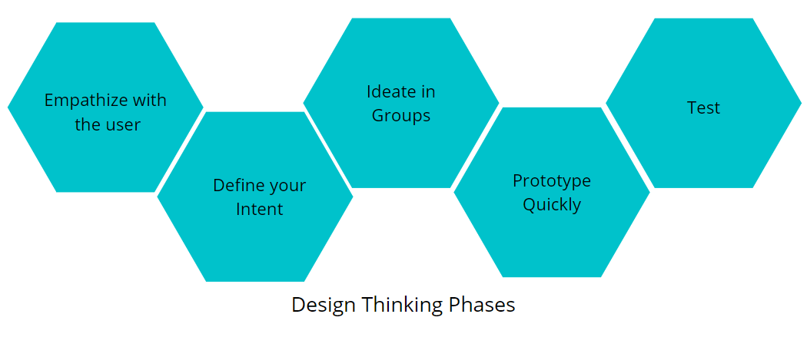
Design Thinking Phases

Slide 4
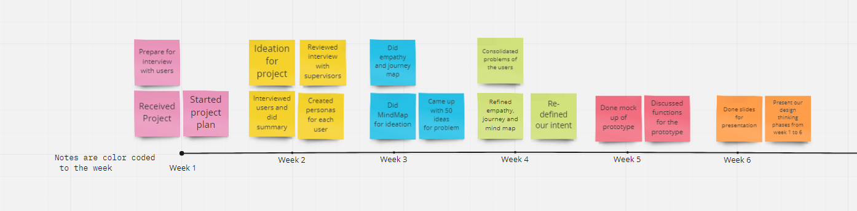
Timeline (Week 1 to Week 6)

Slide 5
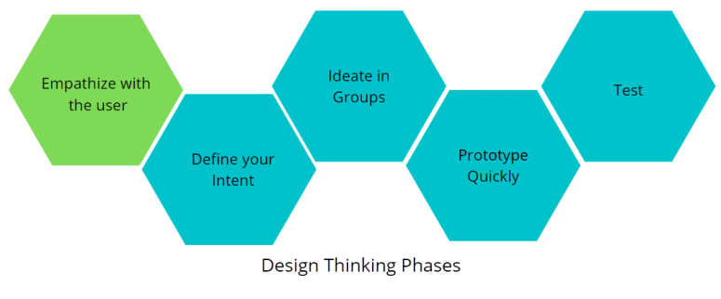
Phase 1: Empathize with the users

Slide 6
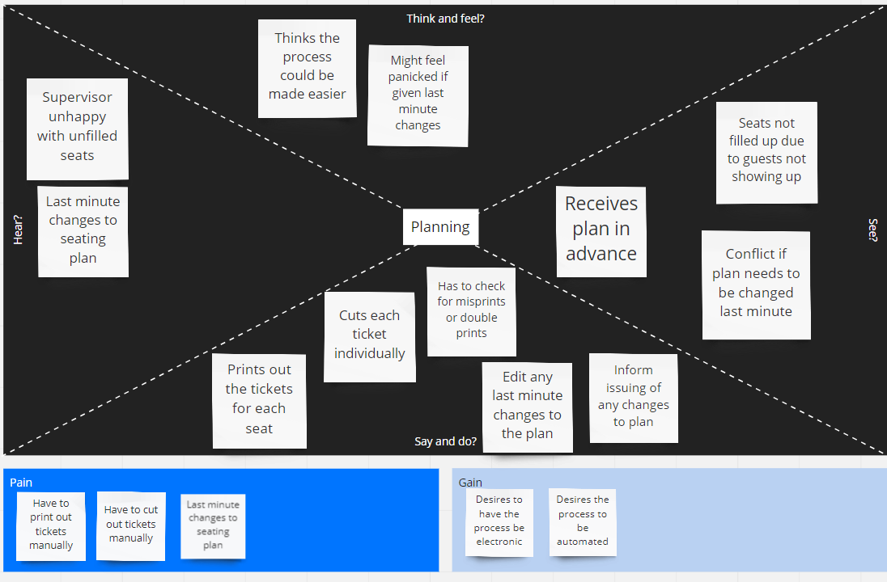
Empathy Map(Planning)

Slide 7
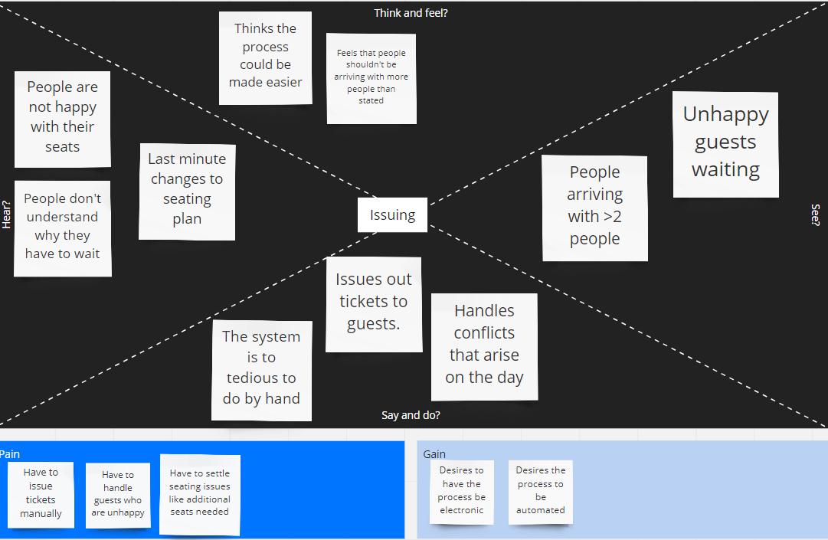
Empathy Map(Issuing)

Slide 8
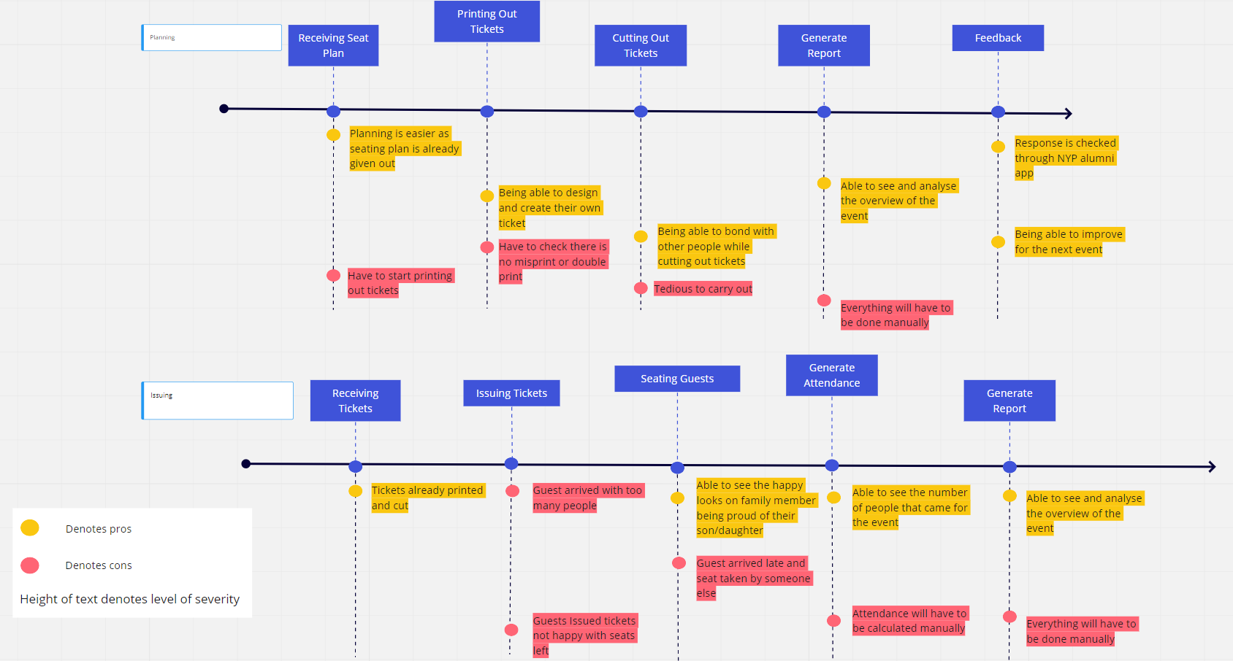
Journey Map

Slide 9
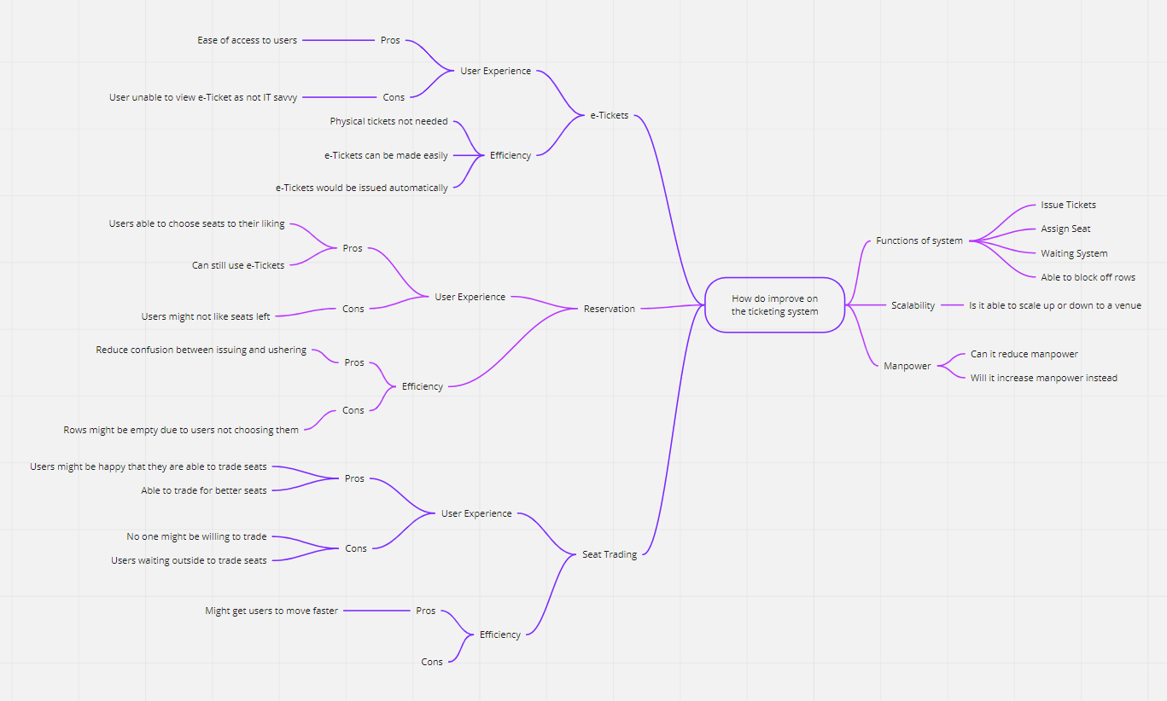
MindMap

Slide 10
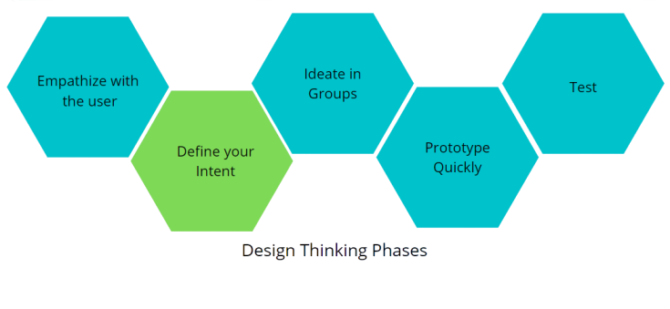
Phase 2: Define your intent

Slide 11
Problem Statement
The problem with the current method of how things works are that huge amount of manpower are used to plan these events. Printing and checking of tickets are tedious and requires huge amount of time do them. Attendance taking and other reports are also done manually. It is tedious and sometimes there will be error too. Since we are not only dedicating this platform to only 1 venue. We have to make it dynamic so that it will be responsive to other types of venues too. Conflicts are definitely bound to happen but the most common conflict would be guest bringing more that stated guest on the day itself.

Slide 12
How Might We (Planner)
How might we help planners ease the usage of manpower?
How might we make planning smoother for planners?
How might we make the platform easy to use by all ages?

Slide 13
How Might We (Ushering & Ticket Issuer)
How might we reduce guest conflict between guest and usher?
How might we make the process less tedious and messy?
How might we reduce the use of paper to save the environment?
How might we satisfy all type of guest?
How might we help out the ushers and ticket issuers?

Slide 14
How Might We (Guest)
How might we make guest understand about seat reservation?
How might we make guest with extra guests be happy with compromises?
How might we make guest experience good and smooth?
How might we guest understand their seating arrangement?

Slide 15
Interview
Ms Kareen Koh (Planner)
JunJie & Sherwinn (Event Supervisor and Ticketing)
Ms Loh Moi Yong (Planner)

Slide 16
Ms Kareen Koh
In-charge of handling movie nights and entrepreneurship talk/networking talk
Entrepreneurship/Networking talk
No seating arrangement, first come first serve
Movie Nights
Start from middle to back seats, filling up on the middle 6-8 seats, proceeding to the back row till all the middle seats are filled.
Work on the seats left and right from the middle

Slide 17
Ms Kareen Koh
Alumni are involved as well for ushering and giving out tickets
Does not have any limitation/difficulties so far (have not encountered any)
Movie Theatre does include handicap seats
Does have conflicts
Customers not happy with their seats
Late customer found other people seating in their seats

Slide 18
JunJie
In-charge of attendance, ushering, supervising and handling conflicts
Common conflict
Max is only 2 people where a lot of group came in more than 2

Slide 19
Sherwinn
In-charge of issuing tickets
Process
Signup through link
Scanning QR Code on phone
Issuing tickets manually
What he does not like
Ticket are not automatic, resulting in lots of manpower used and messy

Slide 20
Sherwinn
Conflicts
Most common conflicts would be people not liking their seats as they are first come first serve
What they would like to have in the app
Waiting list for extra people

Slide 21
Ms Loh Moi Yong
In-charge of color-coding, planning seats and printing out tickets
Preparation are done months beforehand
Her difficulty would be having to cut out the tickets

Slide 22

Interview Snips (Ms Kareen Koh)
Talking about seating arrangement for Network gathering, Entrepreneur talk and movie nights
“Had not encounter this issue yet. But there are handicap seats in the movie theatre.”

Slide 23
Interview Snips (Ms Kareen Koh)
“It is flexible in a sense that i can note in any seating arrangement depending on what the cinema give me”
Pain point is more on double checking for payment on the AXS machine

Slide 24
Interview Snips (Ms Kareen Koh)
“For things that you may want to implement. Being able to go in and slot in the amount of rows and column”
People being late and their seat being taken

Slide 25
Interview Snips (Junjie)
People coming in with more than 2 guests
“For those extra families that come, they have to write down their name and everything. I think you can continue to implement this”

Slide 26
Interview Snips (Junjie)
“It is okay if you guys do reserve?”
We have explained to him why reserve could be bad but it is a function that can be kept if we want to implement it in the future.
Details on why he think reserve would be good.

Slide 27
Interview Snips (Sherwinn)
“Giving of tickets is not automatic but manually. We need quite a lot of manpower. A little bit messy”
“Seatings will be in the QR code. Put up a waiting list for extra families members to go in”
“People not being happy with their seats”

Slide 28
Interview Snips (Ms Loh Moi Yong)
This is the Ms Moh talking about what she feel is the most tedious part.
“The most tedious part would be the cutting of tickets”

Slide 29
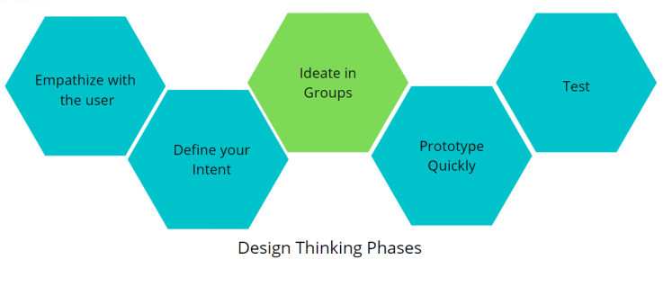
Phase 3: Ideate in Groups

Slide 30
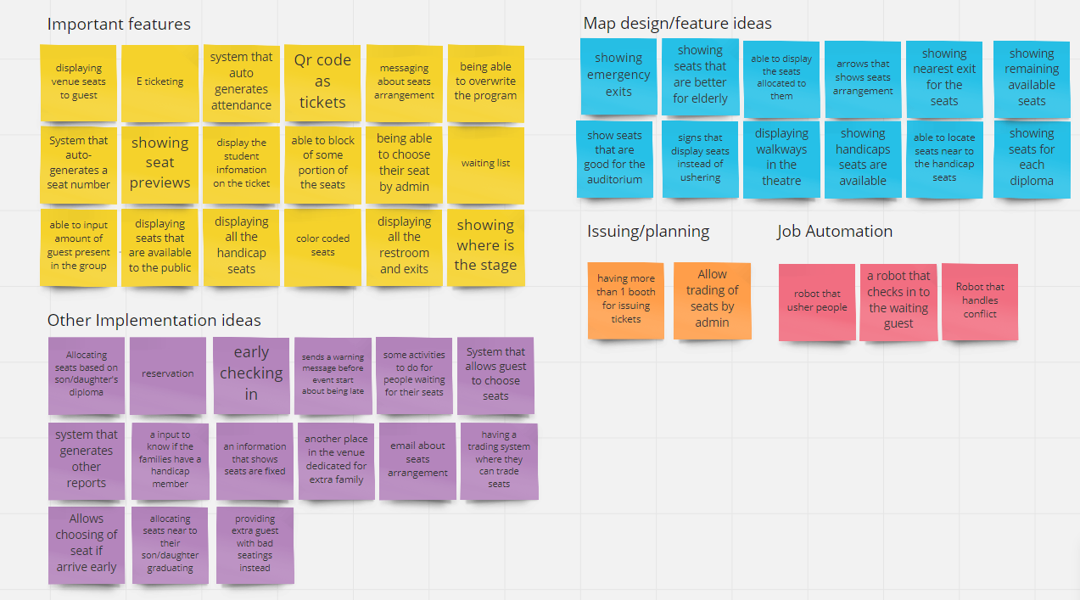
50 Ideas

Slide 31
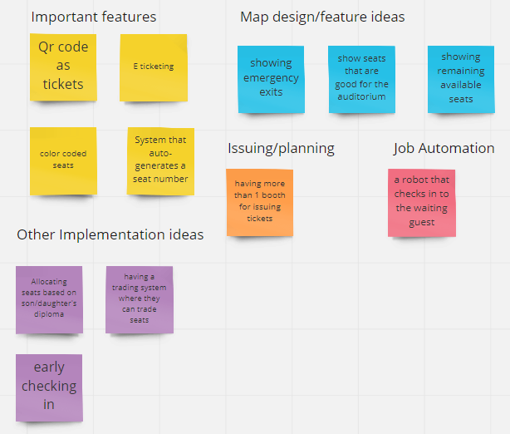
50 Ideas

Slide 32
Selection Matrix
Idea selected (Score) | Desirability | Feasibility | Viability | Novelty
e-Ticketing (10) | 3 | 3 | 3 | 1
Waiting List(7) | 2 | 2 | 2 | 1
Generating Reports(9) | 3 | 3 | 2 | 1

Slide 33
Proposed Solution
Our proposed solution would be an e-Ticketing system that would issue users tickets based on the availability of seats. It should also be easy to use and navigate for all ages.

Slide 34
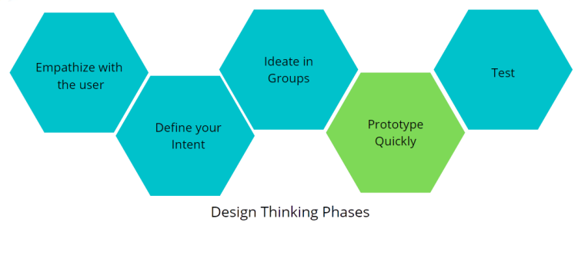
Phase 4: Prototype (Planner Side)

Slide 35
Function List
Planner
Able to pick venue
Able to block off certain rows and reserve seats
Able to key in date and time for the event
Save/Edit/Cancel Button
Issuing Tickets
Auto generate seats
Send message about seating arrangement for reference for usher (e-Ticketing)

Slide 36
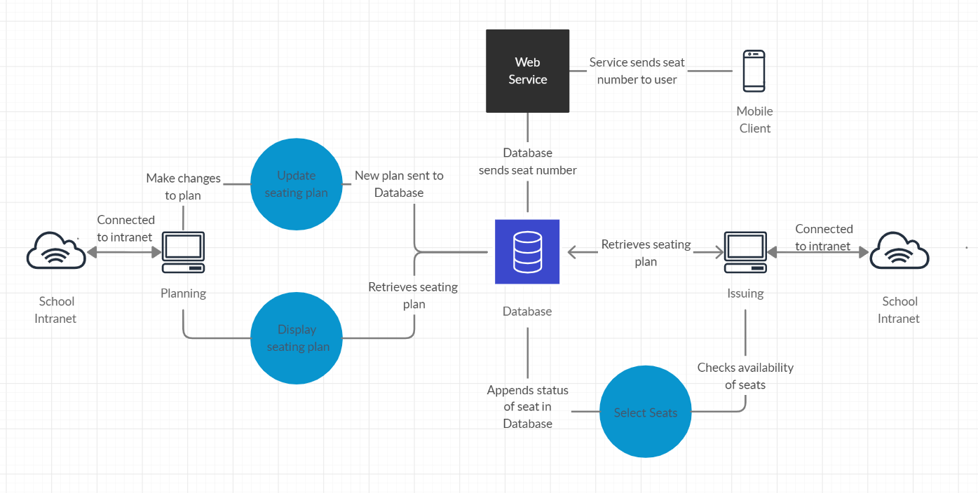
System Diagram

Slide 37
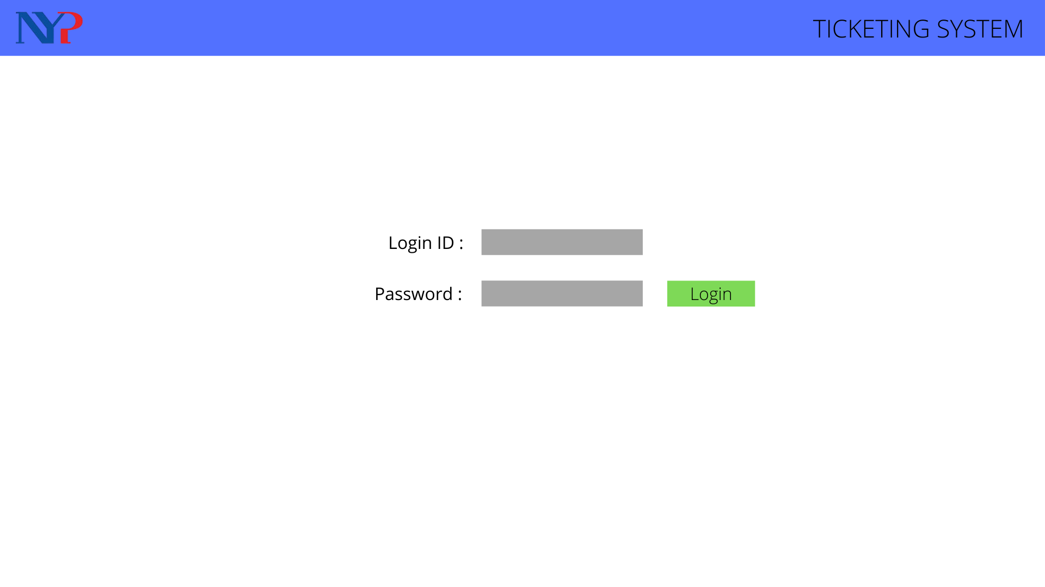
Login Page

Slide 38
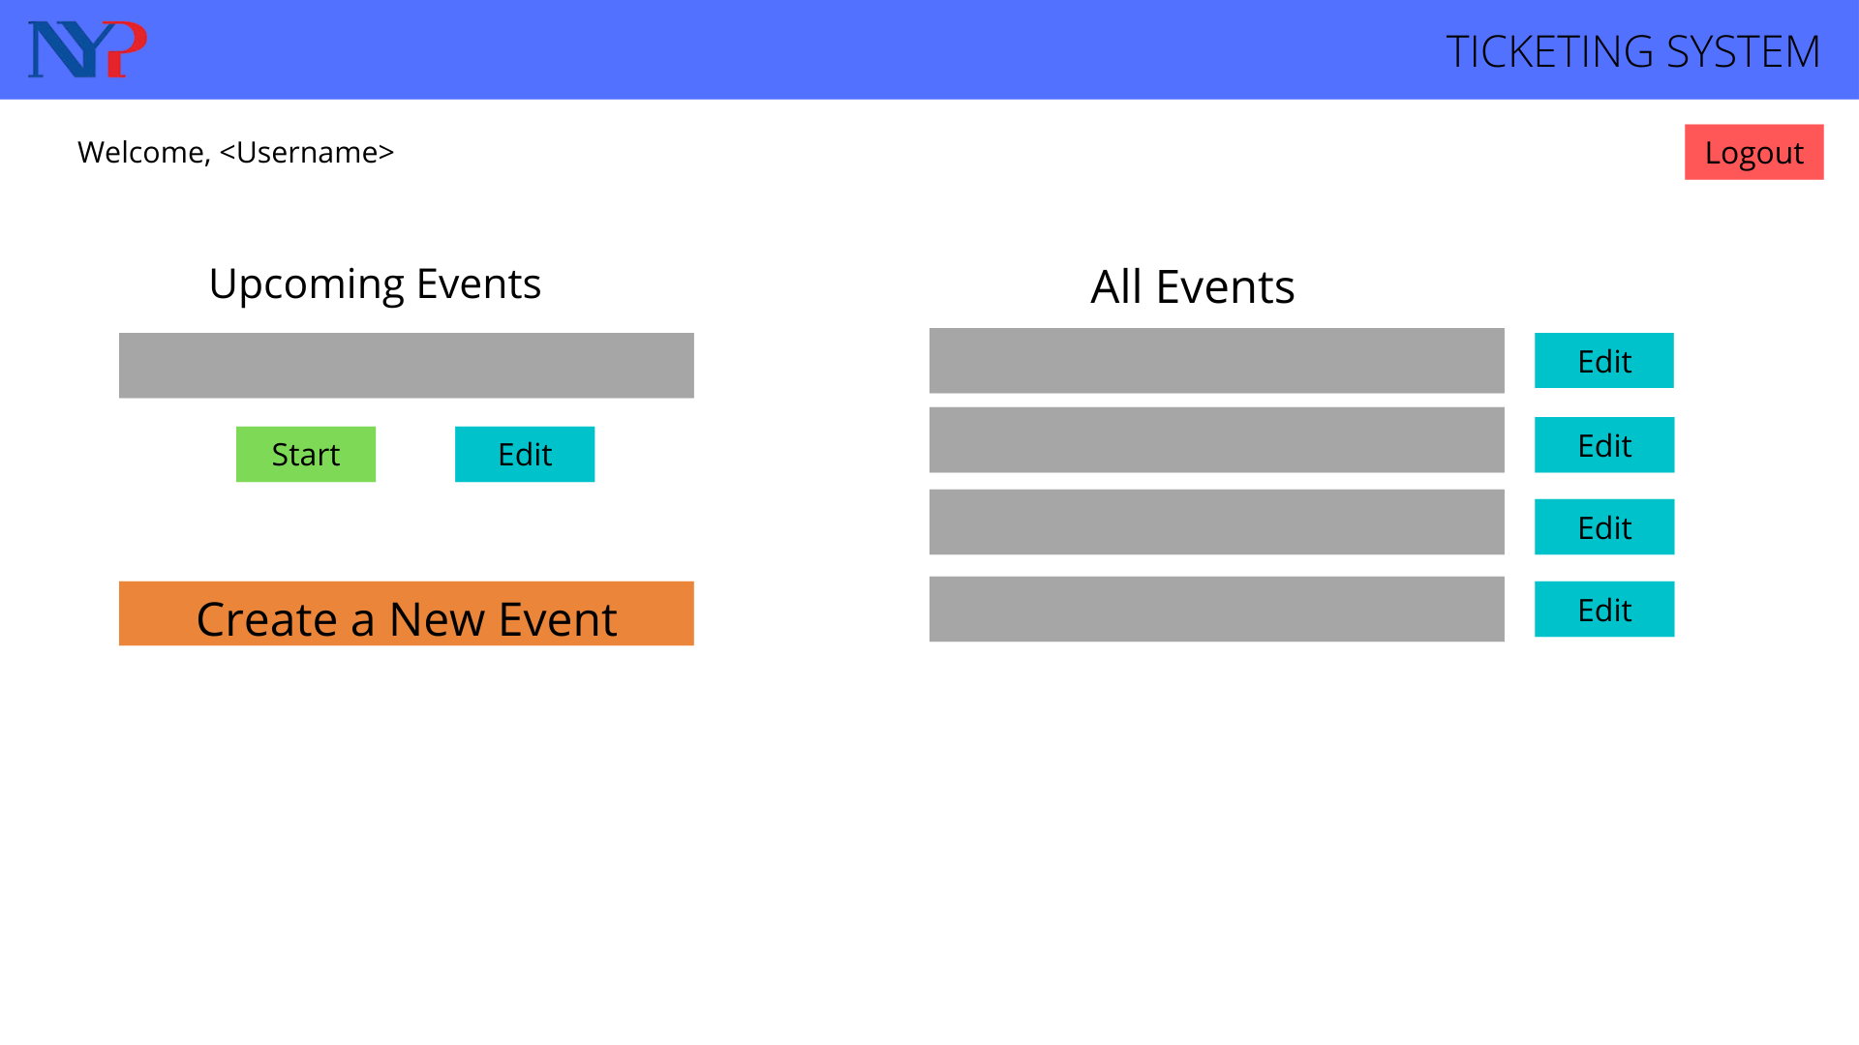
Dashboard

Slide 39
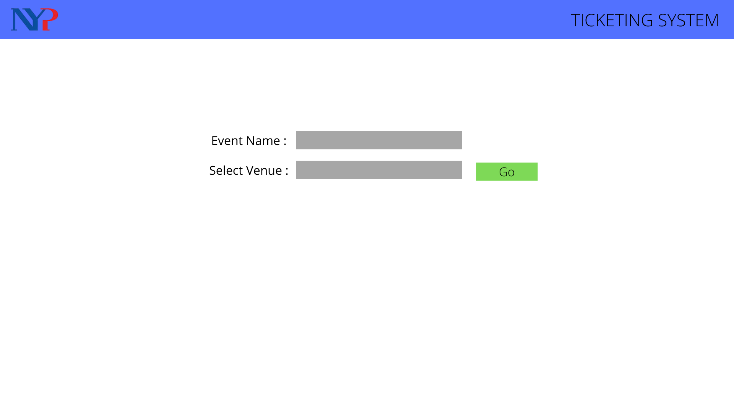
Venue Selection

Slide 40
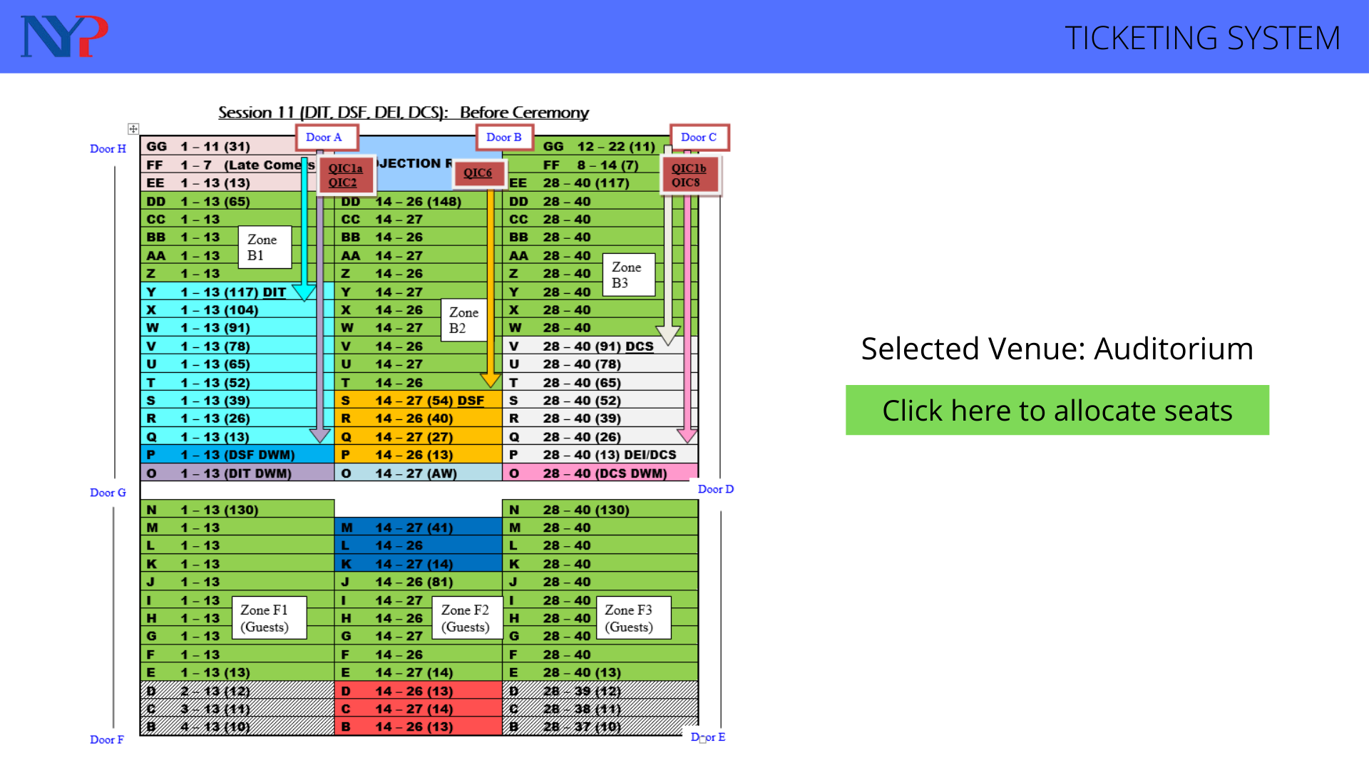
Preview Page

Slide 41
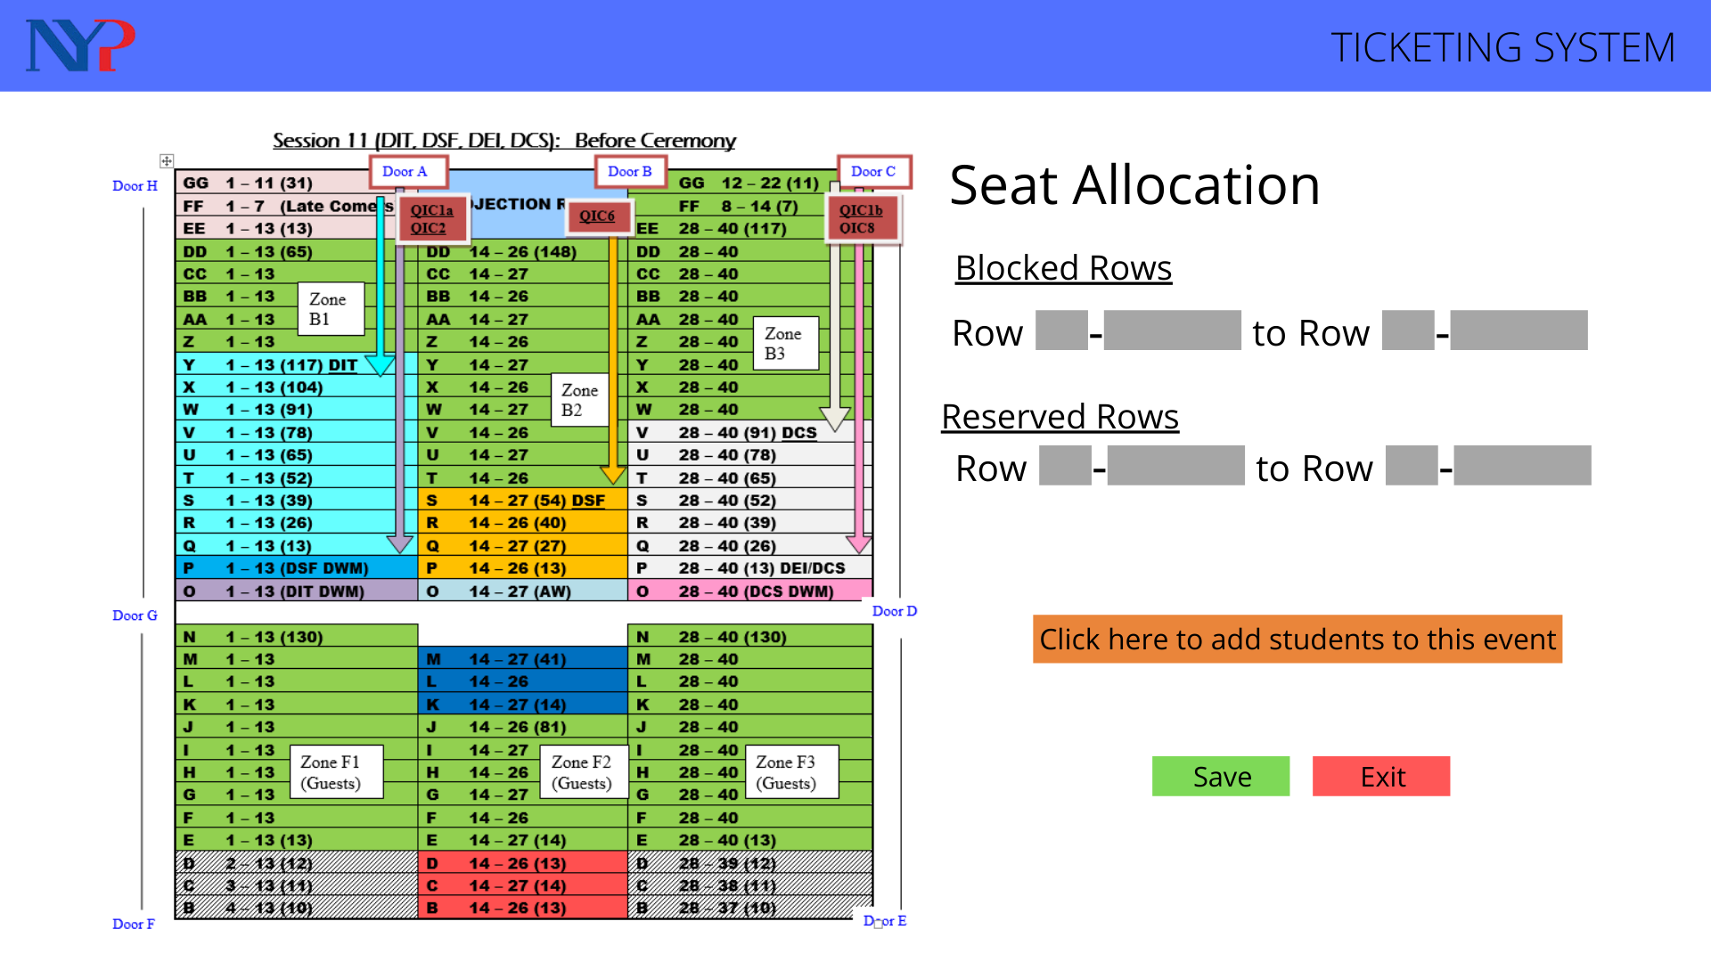
Editing Page

Slide 42
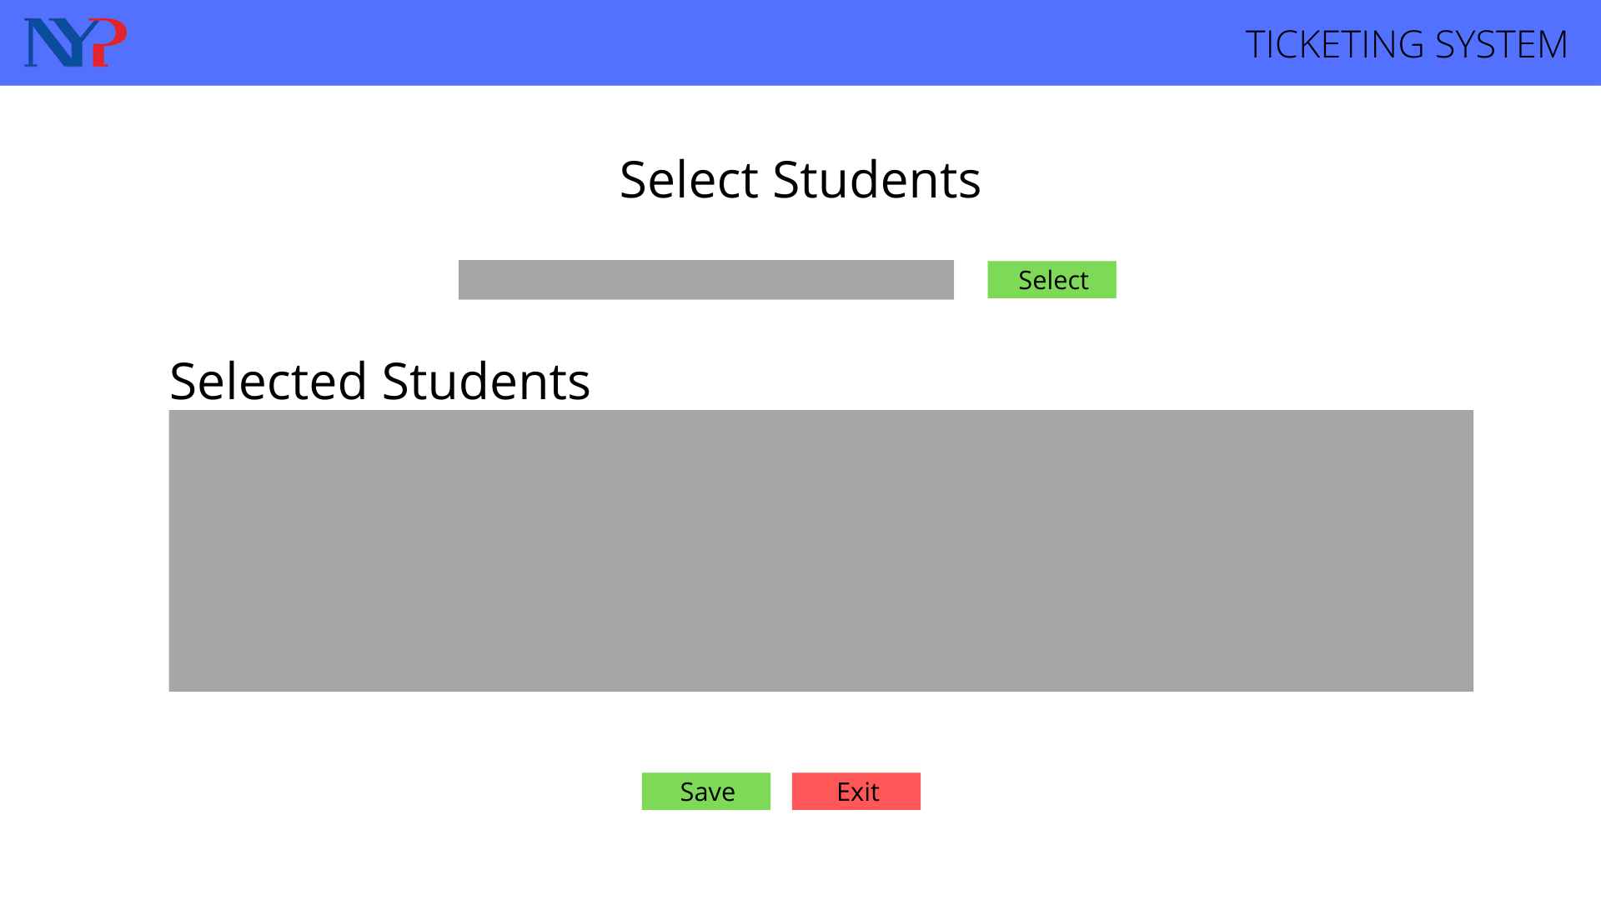
Student Selection

Slide 43
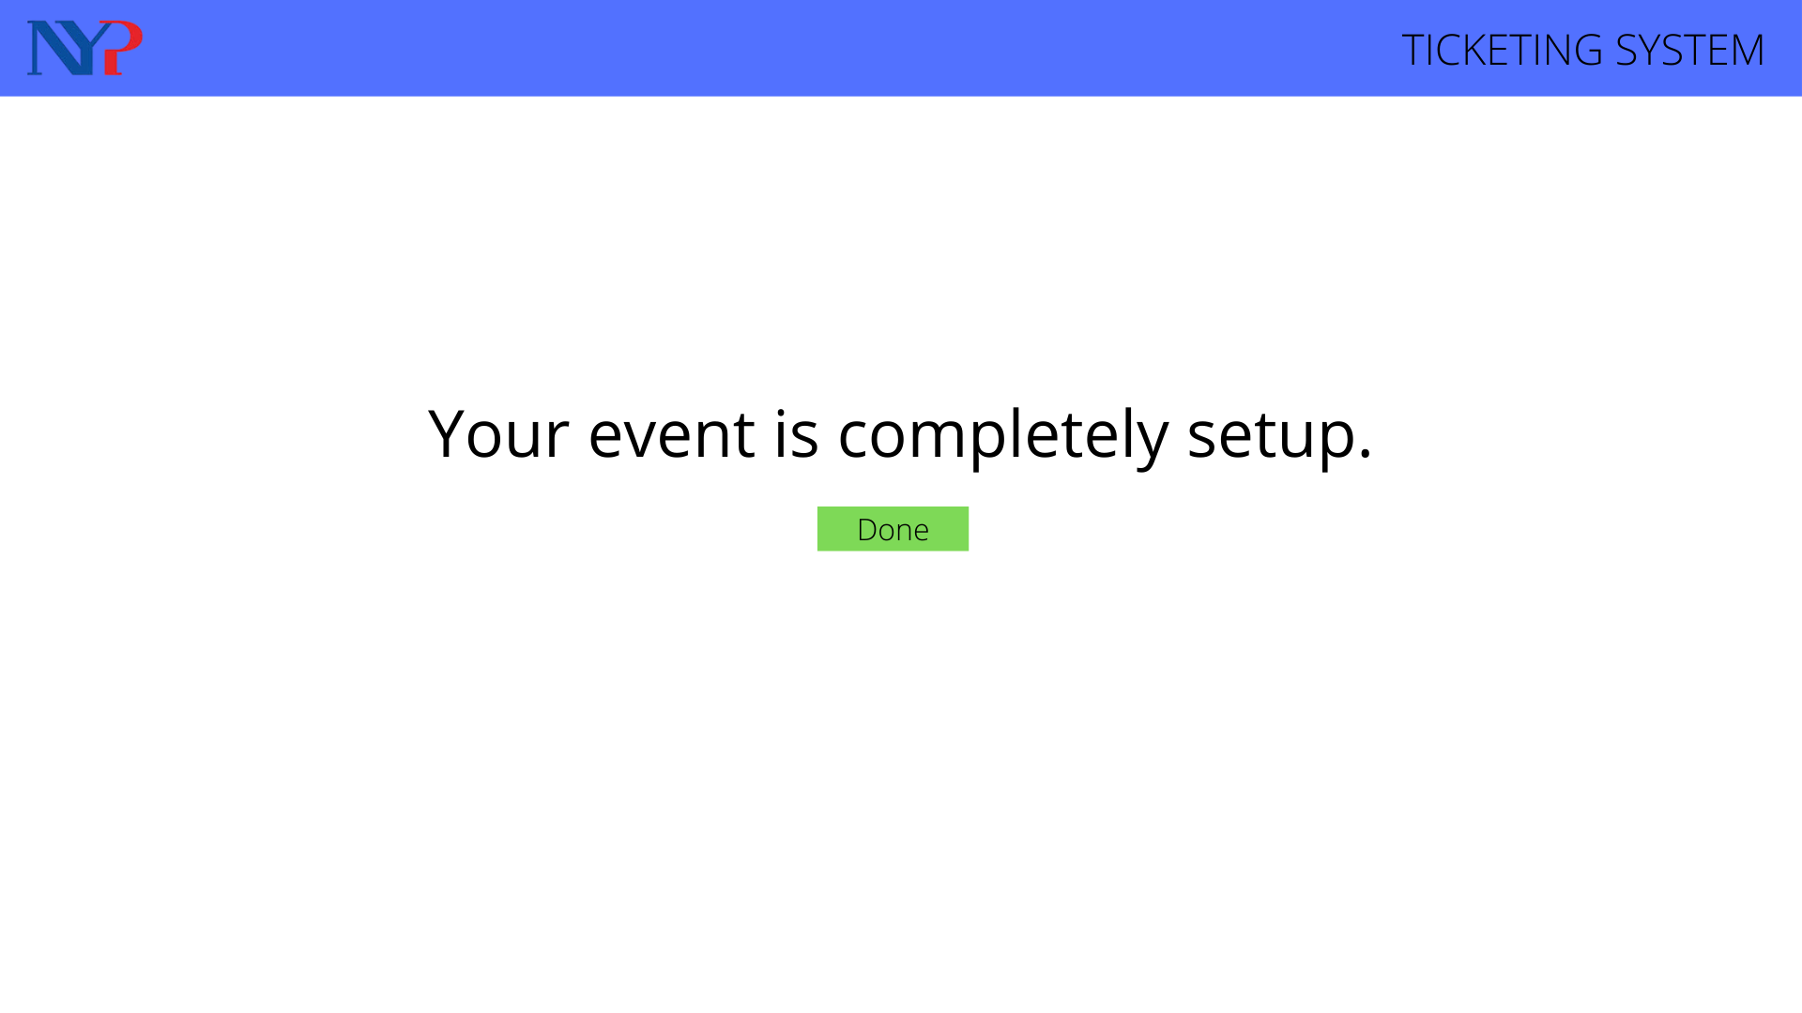
Completion Page

Slide 44
Phase 4: Prototype (Client Side)

Slide 45
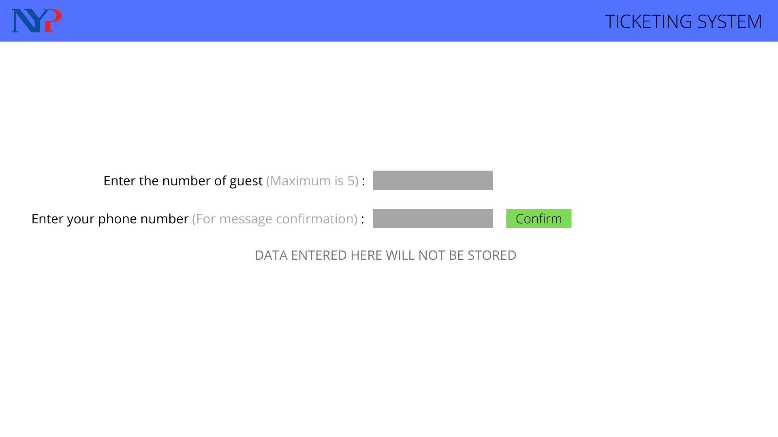
Input Page

Slide 46
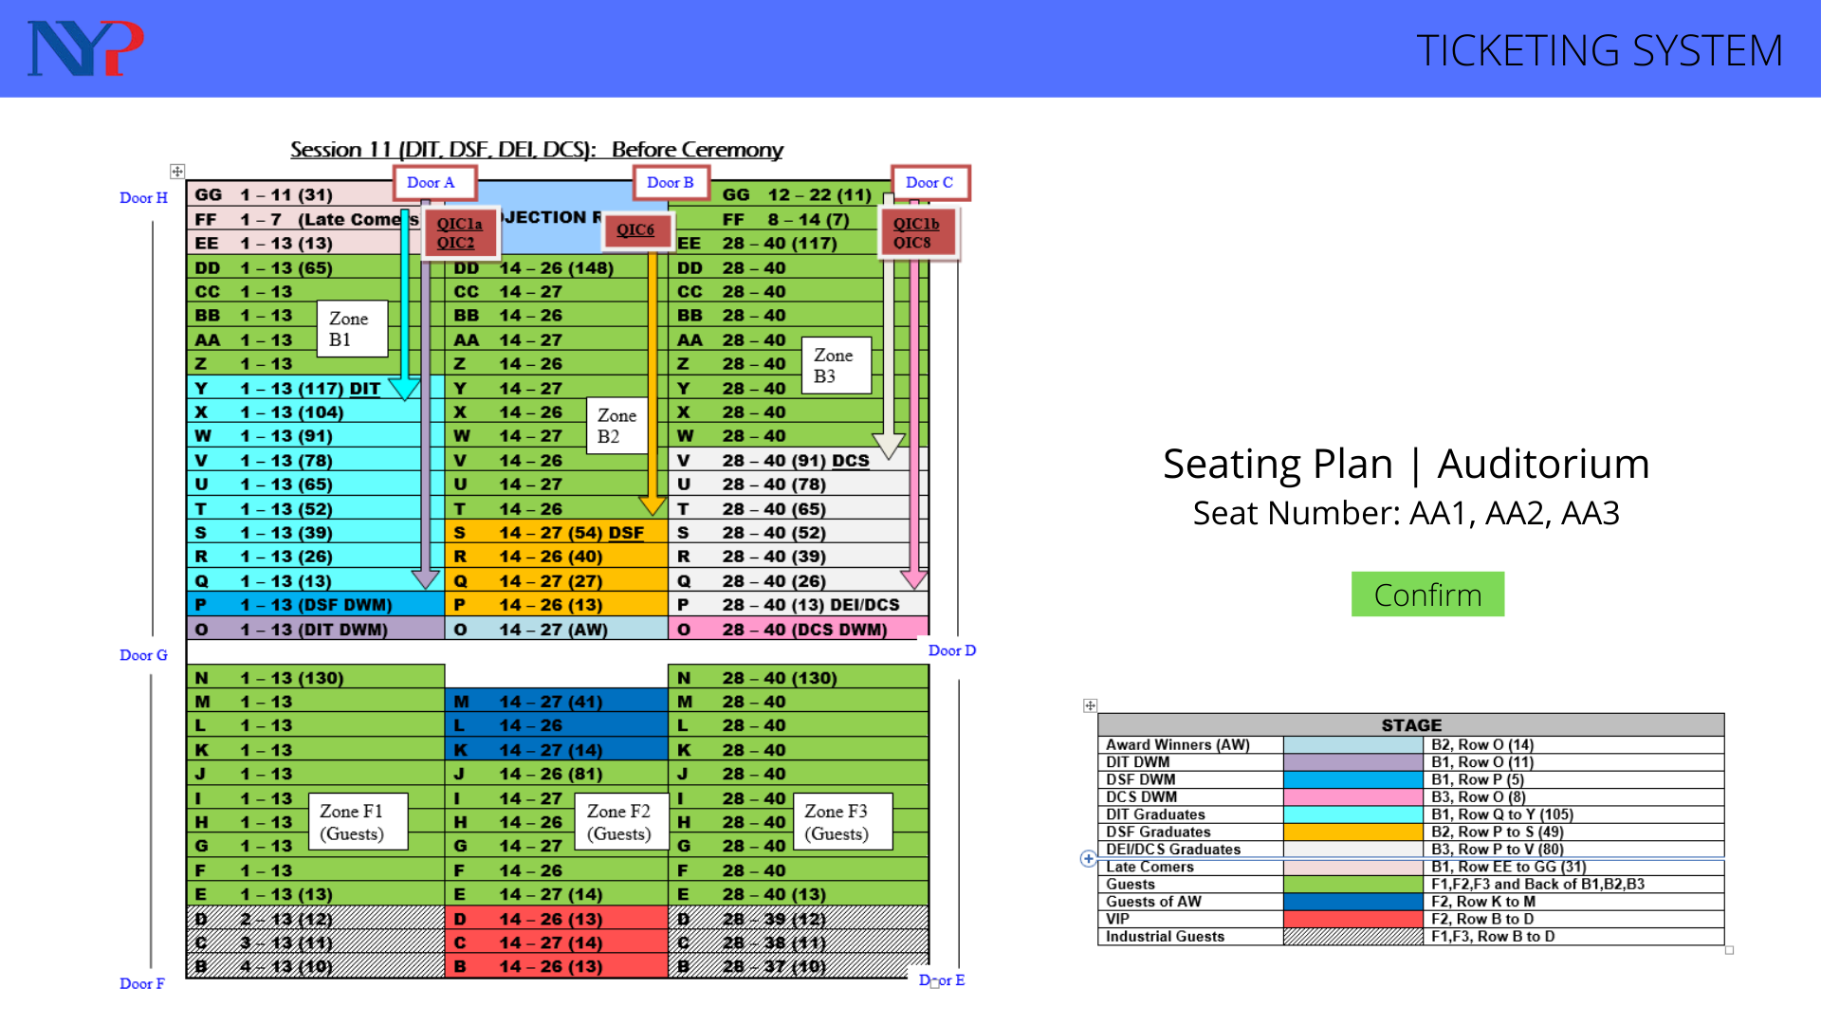
Seating Allocation

Slide 47
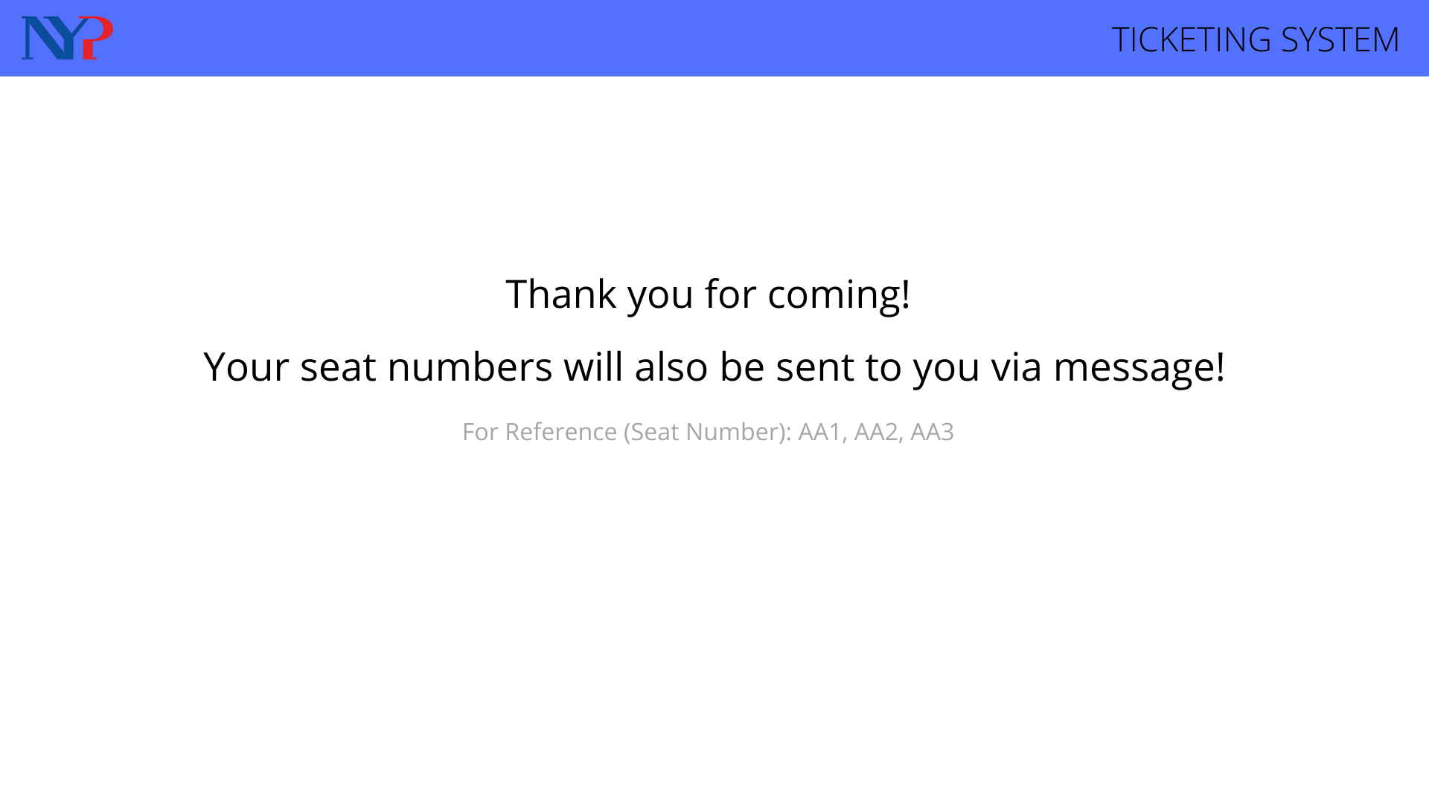
Thank you Page
Text message: Thank you for coming to the graduation ceremony!
Your assigned seats are at AA1 AA2 and AA3

Slide 48
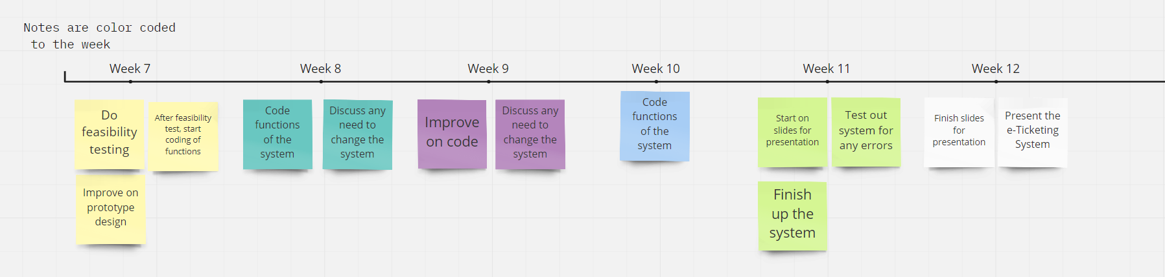
Timeline (Week 7 to Week 12)

Slide 49
Conclusion
Before design thinking, we jumped towards solution instead of taking our time to consider if the solution help the users at all. After design thinking, we narrowed down the problems and thought about solutions that will tackle the problems
Before design thinking, we only have a broad understanding of the problems. But after design thinking, we manage to understand the more challenging parts for the users and narrow down to the important features that will help them.
Design thinking allows us to be in the shoes of the planners, ticket issuers and ushers to understand their problems.

Slide 50
Reflection
We didn’t know much about design thinking. Hence, we had multiple drafts and changes for the mind map.
We also have to contact, arrange and match our timing towards interviewees, so that we could interview them.
We have to read up design thinking slides to help us understand the process better.
We have to maintain discipline as the first 4 weeks was work from home.

Slide 51
The End.
Q&A Section.

